Slide 1
Software Testing and
Software Configuration Management
Session 23
(Tutorial)
Course : COMP6100/Software Engineering
Effective Period : Desember 2017

Slide 2
These slides have been adapted from
Pressman, R.S. (2015). Software Engineering : A Practioner's Approach. 8th ed. McGraw-Hill Companies.Inc, Americas, New York. ISBN : 978 1 259 253157. Chapter 23, 24, 25, 26 and 27
Acknowledgement

Slide 3
LO 4 : Analyze the software project management and the proposed potential business project
Learning Objectives

Slide 4
Contents
Software Testing
White-Box Testing
Black-Box Testing
Testing Concepts for Web and Mobile Apps
The Software Configuration
SCM Repository
The SCM Process
Configuration Management for Web and Mobile Apps

Slide 5
Exhaustive Testing
Software Testing
loop < 20 X
14
There are 10 possible paths! If we execute one
test per millisecond, it would take 3,170 years to
test this program!!

Slide 6
Selective Testing
Software Testing
Selected path
loop < 20 X

Slide 7
Software Testing
white-box
methods
black-box
methods
Methods
Strategies

Slide 8

White-Box Testing
... our goal is to ensure that all
statements and conditions have
been executed at least once ...

Slide 9
Basis Path Testing
White-Box Testing
First, we compute the cyclomatic
complexity:
number of simple decisions + 1
or
number of enclosed areas + 1
In this case, V(G) = 4

Slide 10
Cyclomatic Complexity
White-Box Testing
A number of industry studies have indicated
that the higher V(G), the higher the probability
or errors.
modules
V(G)
modules in this range are
more error prone

Slide 11
Basis Path Testing Notes
White-Box Testing
you don't need a flow chart,
but the picture will help when
you trace program paths
count each simple logical test,
compound tests count as 2 or
more
basis path testing should be
applied to critical modules

Slide 12
Graph Matrices
White-Box Testing
A graph matrix is a square matrix whose size (i.e., number of rows and columns) is equal to the number of nodes on a flow graph
Each row and column corresponds to an identified node, and matrix entries correspond to connections (an edge) between nodes.
By adding a link weight to each matrix entry, the graph matrix can become a powerful tool for evaluating program control structure during testing

Slide 13
Loop Testing
White-Box Testing
Simple
loop
Nested
Loops
Concatenated
Loops
Unstructured
Loops

Slide 14
Black-Box Testing
requirements
output
input
events

Slide 15
Testing Quality Dimensions-I
Testing Concepts for Web and MobileApps
Content is evaluated at both a syntactic and semantic level.
  syntactic level
  semantic level
Function is tested for correctness, instability, and general conformance to appropriate implementation standards (e.g.,Java or XML language standards).
Structure is assessed to ensure that it
  properly delivers WebApp content and function
  is extensible
  can be supported as new content or functionality is added.
Usability is tested to ensure that each category of user
  is supported by the interface
  can learn and apply all required navigation syntax and semantics
Navigability is tested to ensure that
  all navigation syntax and semantics are exercised to uncover any navigation errors (e.g., dead links, improper links, erroneous links).

Slide 16
Testing Concepts for Web and MobileApps
Testing Quality Dimensions-II
Performance is tested under a variety of operating conditions, configurations, and loading to ensure that
  the system is responsive to user interaction
  the system handles extreme loading without unacceptable operational degradation
Compatibility is tested by executing the WebApp in a variety of different host configurations on both the client and server sides.
  The intent is to find errors that are specific to a unique host configuration.
Interoperability is tested to ensure that the WebApp properly interfaces with other applications and/or databases.
Security is tested by assessing potential vulnerabilities and attempting to exploit each.
  Any successful penetration attempt is deemed a security failure.

Slide 17
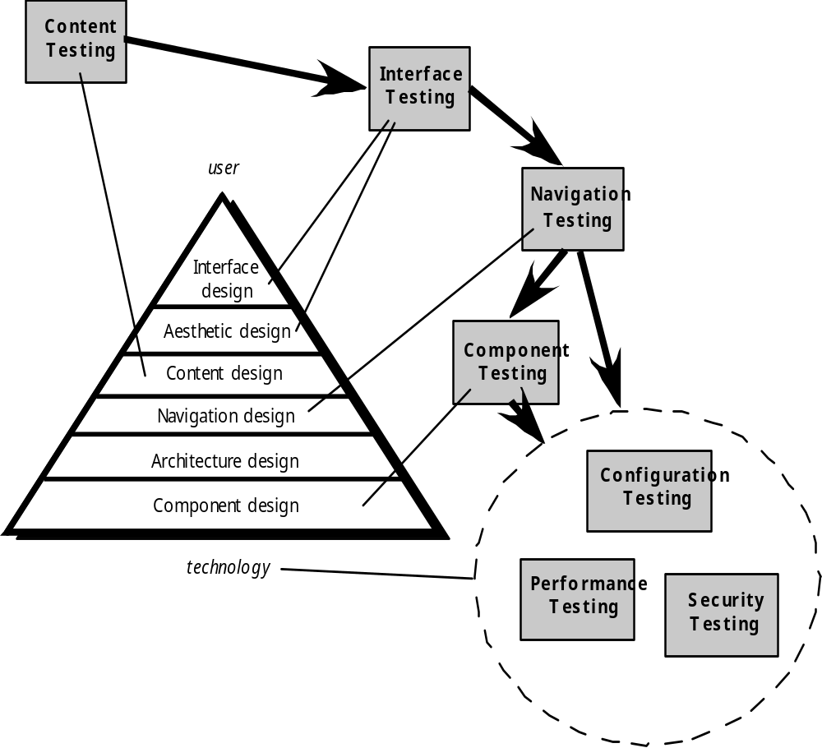
The Testing Process
Testing Concepts for Web and MobileApps

Slide 18
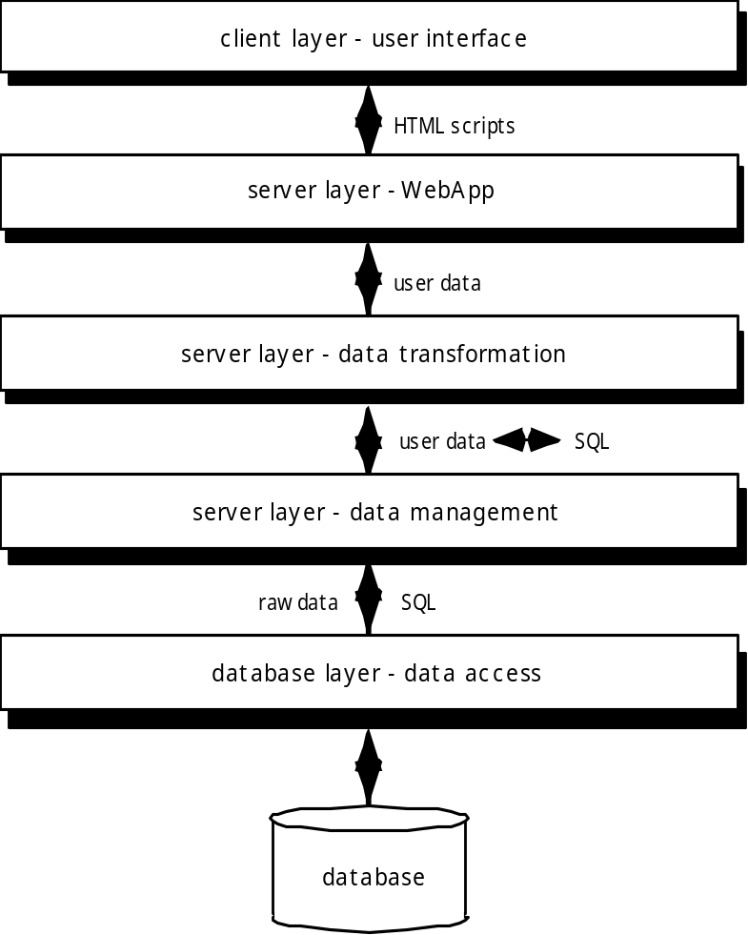
Database Testing
Testing Concepts for Web and MobileApps
Tests are defined for
each layer

Slide 19
Testing Interface Mechanisms-I
Testing Concepts for Web and MobileApps
Links—navigation mechanisms that link the user to some other content object or function.
Forms—a structured document containing blank fields that are filled in by the user. The data contained in the fields are used as input to one or more WebApp functions.
Client-side scripting—a list of programmed commands in a scripting language (e.g., Javascript) that handle information input via forms or other user interactions
Dynamic HTML—leads to content objects that are manipulated on the client side using scripting or cascading style sheets (CSS).
Client-side pop-up windows—small windows that pop-up without user interaction. These windows can be content-oriented and may require some form of user interaction.

Slide 20
Testing Interface Mechanisms-II
Testing Concepts for Web and MobileApps
CGI scripts—a common gateway interface (CGI) script implements a standard method that allows a Web server to interact dynamically with users (e.g., a WebApp that contains forms may use a CGI script to process the data contained in the form once it is submitted by the user).
Streaming content—rather than waiting for a request from the client-side, content objects are downloaded automatically from the server side. This approach is sometimes called “push” technology because the server pushes data to the client.
Cookies—a block of data sent by the server and stored by a browser as a consequence of a specific user interaction. The content of the data is WebApp-specific (e.g., user identification data or a list of items that have been selected for purchase by the user).
Application specific interface mechanisms—include one or more “macro” interface mechanisms such as a shopping cart, credit card processing, or a shipping cost calculator.

Slide 21
Navigation Testing
Testing Concepts for Web and MobileApps
The following navigation mechanisms should be tested:
Navigation links—these mechanisms include internal links within the WebApp, external links to other WebApps, and anchors within a specific Web page.
Redirects—these links come into play when a user requests a non-existent URL or selects a link whose destination has been removed or whose name has changed.
Bookmarks—although bookmarks are a browser function, the WebApp should be tested to ensure that a meaningful page title can be extracted as the bookmark is created.
Frames and framesets—tested for correct content, proper layout and sizing, download performance, and browser compatibility
Site maps—Each site map entry should be tested to ensure that the link takes the user to the proper content or functionality.
Internal search engines—Search engine testing validates the accuracy and completeness of the search, the error-handling properties of the search engine, and advanced search features

Slide 22
Configuration Testing
Testing Concepts for Web and MobileApps
Server-side
  Is the WebApp fully compatible with the server OS?
  Are system files, directories, and related system data created correctly when the WebApp is operational?
  Do system security measures (e.g., firewalls or encryption) allow the WebApp to execute and service users without interference or performance degradation?
  Has the WebApp been tested with the distributed server configuration (if one exists) that has been chosen?
  Is the WebApp properly integrated with database software? Is the WebApp sensitive to different versions of database software?
  Do server-side WebApp scripts execute properly?
  Have system administrator errors been examined for their affect on WebApp operations?
  If proxy servers are used, have differences in their configuration been addressed with on-site testing?

Slide 23
Configuration Testing
Testing Concepts for Web and MobileApps
Client-side
  Hardware—CPU, memory, storage and printing devices
  Operating systems—Linux, Macintosh OS, Microsoft Windows, a mobile-based OS
  Browser software—Internet Explorer, Mozilla/Netscape, Opera, Safari, and others
  User interface components—Active X, Java applets and others
  Plug-ins—QuickTime, RealPlayer, and many others
  Connectivity—cable, DSL, regular modem, T1
The number of configuration variables must be reduced to a manageable number

Slide 24
Load Testing
Testing Concepts for Web and MobileApps
The intent is to determine how the WebApp and its server-side environment will respond to various loading conditions
  N, the number of concurrent users
  T, the number of on-line transactions per unit of time
  D, the data load processed by the server per transaction
Overall throughput, P, is computed in the following manner:
    P = N x T x D

Slide 25
The Software Configuration
programs
documents
The pieces
data

Slide 26
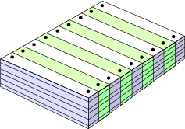
What Are These Changes?
The Software Configuration
changes in
business requirements
changes in
technical requirements
changes in
user requirements
other
documents
software models
Project
Plan
data
Test
code

Slide 27
Baselines
The Software Configuration
The IEEE (IEEE Std. No. 610.12-1990) defines a baseline as:
  A specification or product that has been formally reviewed and agreed upon, that thereafter serves as the basis for further development, and that can be changed only through formal change control procedures.
a baseline is a milestone in the development of software that is marked by the delivery of one or more software configuration items and the approval of these SCIs that is obtained through a formal technical review

Slide 28
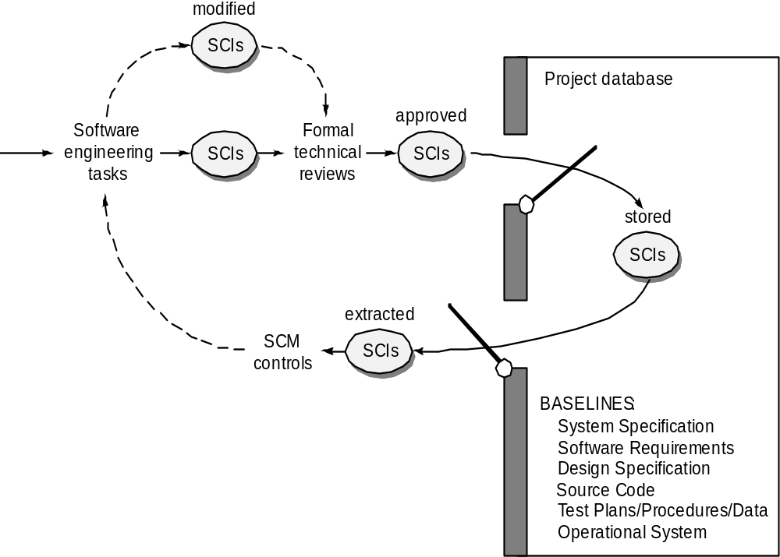
Baselines
The Software Configuration

Slide 29
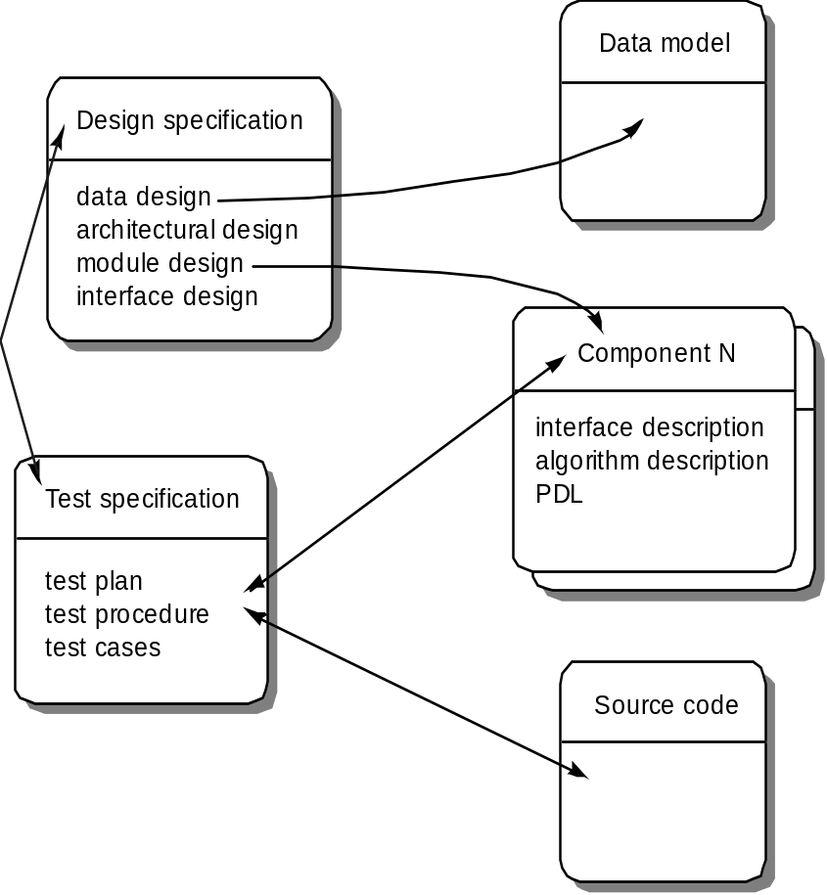
Software Configuration Objects
The Software Configuration

Slide 30
SCM Repository
The SCM repository is the set of mechanisms and data structures that allow a software team to manage change in an effective manner
The repository performs or precipitates the following functions [For89]:
  Data integrity
  Information sharing
  Tool integration
  Data integration
  Methodology enforcement
  Document standardization

Slide 31
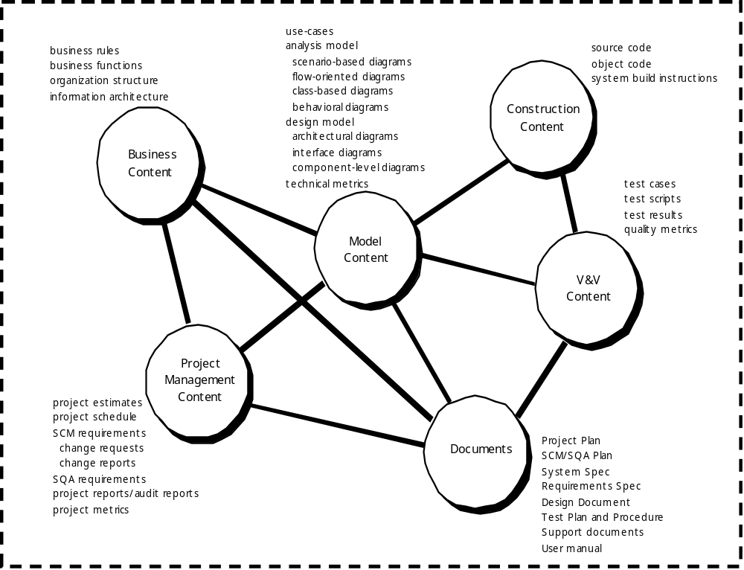
Repository Content
The Software Configuration

Slide 32
Repository Features
The Software Configuration
Versioning.
  saves all of these versions to enable effective management of product releases and to permit developers to go back to previous versions
Dependency tracking and change management.
  The repository manages a wide variety of relationships among the data elements stored in it.
Requirements tracing.
  Provides the ability to track all the design and construction components and deliverables that result from a specific requirement specification
Configuration management.
  Keeps track of a series of configurations representing specific project milestones or production releases. Version management provides the needed versions, and link management keeps track of interdependencies.
Audit trails.
  establishes additional information about when, why, and by whom changes are made.

Slide 33
SCM Elements
The Software Configuration
Component elements—a set of tools coupled within a file management system (e.g., a database) that enables access to and management of each software configuration item.
Process elements—a collection of procedures and tasks that define an effective approach to change management (and related activities) for all constituencies involved in the management, engineering and use of computer software.
Construction elements—a set of tools that automate the construction of software by ensuring that the proper set of validated components (i.e., the correct version) have been assembled.
Human elements—to implement effective SCM, the software team uses a set of tools and process features (encompassing other CM elements)

Slide 34

The SCM Process

Slide 35
Change Control
The SCM Process
STOP

Slide 36
Change Control Process—I
The SCM Process
Need for change is recognized
Change request from user
Developer evaluates
Change report is generated
Change control authority decides
Request is queued for action
Change request is denied
Change control process—II
User is informed

Slide 37
Change Control Process-II
The SCM Process
Request is queued for action
Assign individuals to configuration objects
“Check-out” configuration objects
Make the change
Review (audit )the change
“Check in” the configuration items that have been changed
Establish a baseline for testing
change control process—III

Slide 38
Change Control Process-III
The SCM Process
Perform quality assurance and testing activities
“Promote” changes for inclusion in next release (revision)
Rebuild appropriate version of software
Review (audit) the change to all configuration items
Include changes in new version
Distribute the new version

Slide 39
Auditing
The SCM Process
Change
Requests
SQA
Plan
SCIs
SCM Audit

Slide 40
Status Accounting
The SCM Process
Change
Reports
Change
Requests
ECOs
SCIs
Status Accounting
Reporting

Slide 41
Configuration Management for Web and MobileApps
Content.
  A typical WebApp contains a vast array of content—text, graphics, applets, scripts, audio/video files, forms, active page elements, tables, streaming data, and many others.
  The challenge is to organize this sea of content into a rational set of configuration objects and then establish appropriate configuration control mechanisms for these objects.
People.
  Because a significant percentage of WebApp development continues to be conducted in an ad hoc manner, any person involved in the WebApp can (and often does) create content.

Slide 42
Configuration Management for Web and MobileApps
Scalability.
  As size and complexity grow, small changes can have far-reaching and unintended affects that can be problematic. Therefore, the rigor of configuration control mechanisms should be directly proportional to application scale.
Politics.
  Who ‘owns’ a WebApp?
  Who assumes responsibility for the accuracy of the information on the Web site?
  Who assures that quality control processes have been followed before information is published to the site?
  Who is responsible for making changes?
  Who assumes the cost of change?

Slide 43
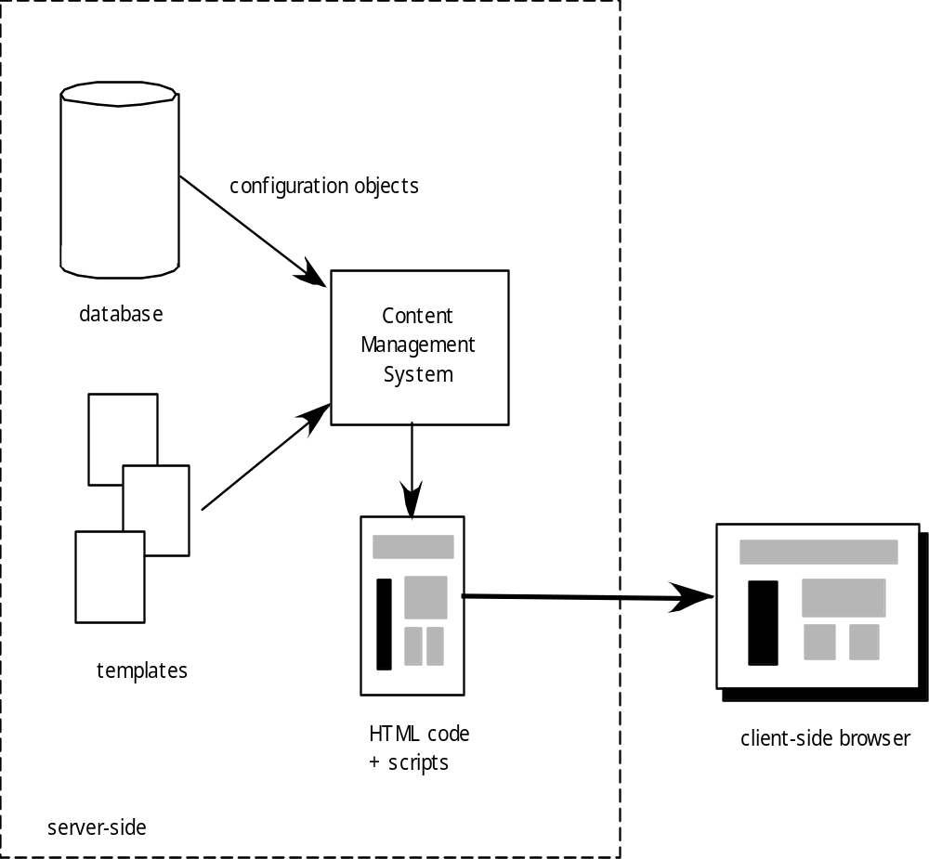
Content Management
Configuration Management for Web and MobileApps

Slide 44
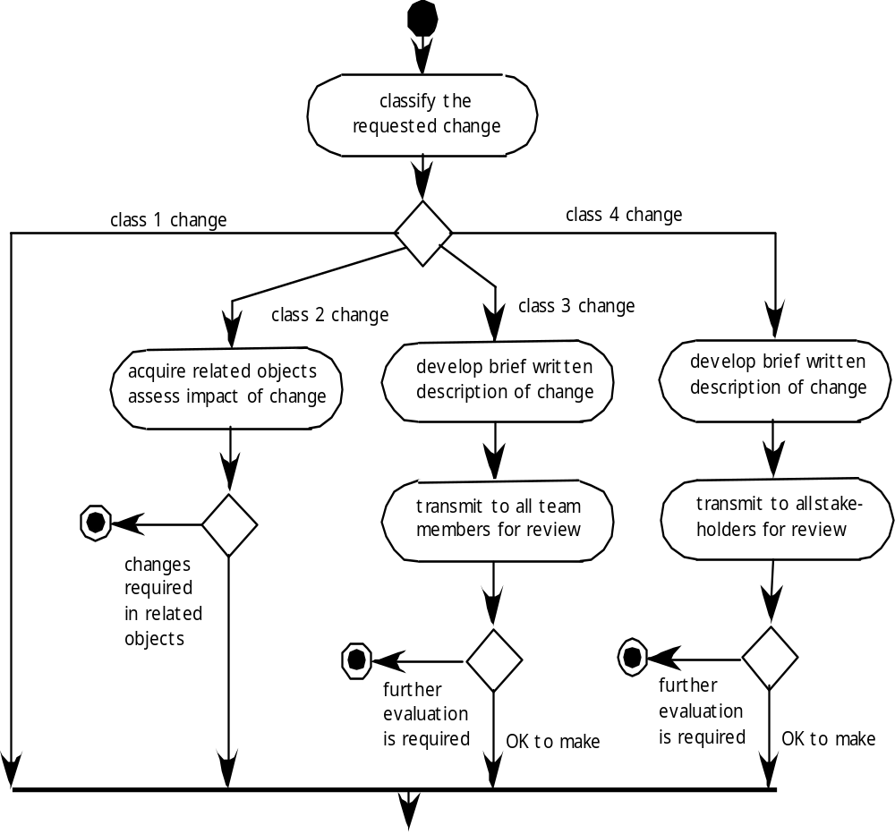
Change Management for WebApps-I
Configuration Management for Web and MobileApps

Slide 45
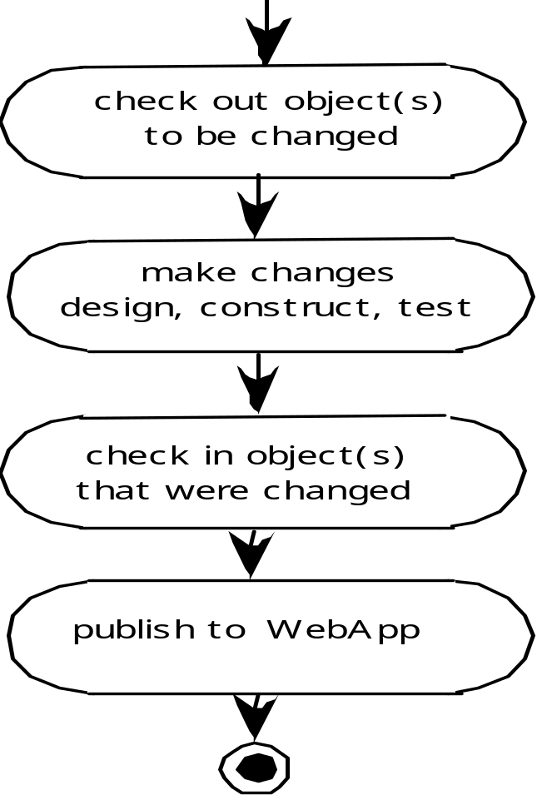
Change Management for WebApps-II
Configuration Management for Web and MobileApps

Slide 46
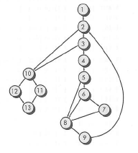
Exercises
What is the difference between black-box and white-box testing ?
Determine the cyclomatic complexity and define the independent paths of the below flow graph :

Slide 47
Exercises
In your own words, describe why the class is the smallest reasonable unit for testing wlthin an OO system
What is the difference between thread-based and use-based strategies for integration testing? How does cluster testing fit in?
Compatibility is an important quality dimension. What must be tested to ensure that compatibility exisis for a WebApp ?
What is the difference between testing for navigation syntax and navigation semantics?
Assume that you're the manager of a small project. What baselines would you define for the project and how would you control them?
Briefly describe the differences between SCM for conventional software and SCM for WebApps

Slide 48
References
Pressman, R.S. (2015). Software Engineering : A Practioner's Approach. 8th ed. McGraw-Hill Companies.Inc, Americas, New York. ISBN : 978 1 259 253157.
Software Testing
http://www.io.com/~wazmo/qa/
SW Testing Storm
http://www.mtsu.edu/~storm
Conventional sw testing
http://www.testingexcellence.com/conventional-software-testing-on-an-extreme-programming-team/
Testing OO SW
http://diwww.epfl.ch/researchlgl/research/ongoing/testing.html
Web testing
http://www.manageengine.com/products/qengine/web-testing.html

Slide 49
Q & A

